Slide 1


© 2014 Microsoft Corporation. All rights reserved. Microsoft, Windows, and other product names are or may be registered trademarks and/or trademarks in the U.S. and/or other countries.
The information herein is for informational purposes only and represents the current view of Microsoft Corporation as of the date of this presentation. Because Microsoft must respond to changing market conditions, it should not be interpreted to be a commitment on the part of Microsoft, and Microsoft cannot guarantee the accuracy of any information provided after the date of this presentation. MICROSOFT MAKES NO WARRANTIES, EXPRESS, IMPLIED OR STATUTORY, AS TO THE INFORMATION IN THIS PRESENTATION.

Slide 2

Microsoft
DevCamp
Advanced Topics

Slide 3
Windows App Lifecycle

Slide 4
Foreground Application Lifecycle

Slide 5
Application Lifetime
Activated
Suspending
Running
Apps can be in 1 of 3 states
Not Running
Running
Suspended
Application receive events when transitioning between states
Except: Suspended->NotRunning
NotRunning
Suspended
Resuming

Slide 6
Application Lifetime
Running
Suspended
Running
Suspended
Not Running
Memory
Usage
CPU
Activated
Suspended
Resumed
Suspended

Slide 7
… but what if I need more time?

Slide 8
Extended Execution
Running
Extension
Suspended
Continue a session when not in the foreground
Memory
RequestExtension()
Suspended
Revoked

Slide 9
Extended Execution
Running
Extension
Not Running
Memory
Applications must supply a reason
Revoked events will have <1 sec to clean up
Request
Suspend
NavigatedAway
Revoked

Slide 10
Code Sample
private async void StartTbTNavigationSession() { using (var session = new ExtendedExecutionSession()) { session.Reason = ExtendedExecutionReason.LocationTracking; session.Description = "Turn By Turn Navigation"; session.Revoked += session_Revoked; var result = await session.RequestExtensionAsync(); if (result == ExtendedExecutionResult.Denied { ShowUserWarning("Background location tracking not available"); } // Do Navigation var completionTime = await DoNavigationSessionAsync(session); } }

Slide 11
Background Execution

Slide 12
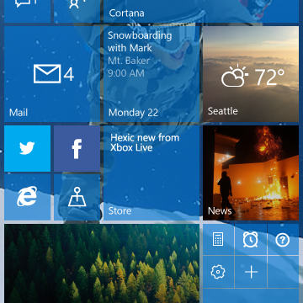

Background Execution
Apps provide real-time content even when suspended
Draw users into your app
Delight them with features

Slide 13
Trigger based Background Tasks
Apps subscribe to triggers they are interested in Only run *when* trigger is fired
Example: Push notification
Geofencing BLE device
Timer App Services

Slide 14
Registering a background task
private void RegisterBackgroundTasks() { BackgroundTaskBuilder builder = new BackgroundTaskBuilder(); builder.Name = "Background Test Class"; builder.TaskEntryPoint = "BackgroundTaskLibrary.TestClass"; IBackgroundTrigger trigger = new TimeTrigger(30, true); builder.SetTrigger(trigger); IBackgroundCondition condition = new SystemCondition(SystemConditionType.InternetAvailable); builder.AddCondition(condition); IBackgroundTaskRegistration task = builder.Register(); task.Progress += new BackgroundTaskProgressEventHandler(task_Progress); task.Completed += new BackgroundTaskCompletedEventHandler(task_Completed); }

Slide 15
Triggers
SystemTrigger
TimeTrigger
MaintenanceTrigger
DeviceUseTrigger
DeviceServicingTrigger
PushNotificationTrigger
CachedFileUpdaterTrigger
DeviceConnectionChangeTrigger
GattCharacteristicNotificationTrigger
RfcommConnectionTrigger
LocationTrigger
AppointmentStoreNotificationTrigger
ContactStoreNotificationTrigger
BluetoothLEAdvertisementWatcherTrigger
BluetoothLEAdvertisementPublisherTrigger
DeviceWatcherTrigger
ActivitySensorTrigger
SensorDataThresholdTrigger
ToastNotificationHistoryChangedTrigger
ToastNotificationActionTrigger
ApplicationTrigger
MediaProcessingTrigger
SocketActivityTrigger
Windows 8.1
Windows 10
WP 8.1

Slide 16
Resource Management
Default Background Tasks
Guaranteed minimum execution time of 25 secs
Example 512MB Mobile device
Default
Oppurtunistic
Memory
Task type | Memory Cap MB | Lifetime | CPU | Block in Batt-Sav
Default Background Task | 16 | 30 sec | 10% | Y
Long-Running | 16 | ∞ | 10% | Y
Opportunistic Background Tasks
Run for as long as resources are available
No guarantee of execution
ApplicationTrigger, MaintenanceTrigger, DeviceUseTrigger
Run()
Cancel()
Run()

Slide 17
In-Proc Background Tasks
App Container
App Container
Default Background Task
Hosted in a separate process
With separate memory caps
In Proc Background Task
Hosted in the specified process
Shares memory caps
app.exe
app.exe
CoreApplication
CoreApplication
backgroundtaskhost.exe
BackgroundTask
BackgroundTask
<Extension Category="windows.backgroundTasks" EntryPoint="BackgroundTasks.TimerTask“
Executable="InProcBackgroundTask.exe">
Same as app exe

Slide 18
Tiles, Notifications and Action Center

Slide 19
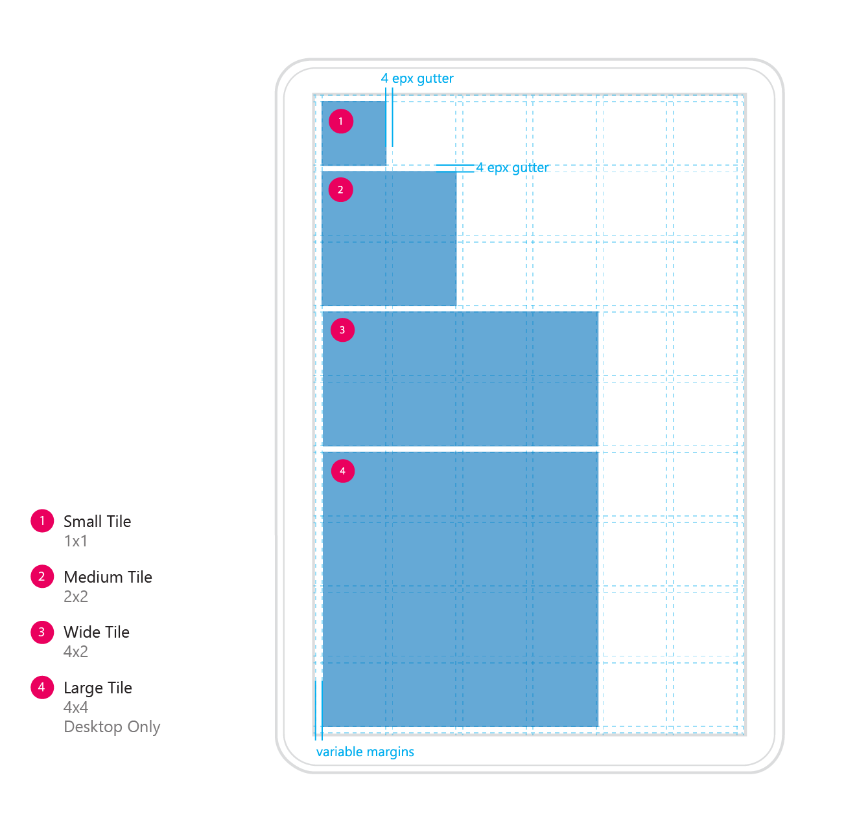
Start Grid
Custom 4 effective pixel grid Using the omni, 4px grid as our foundation, we updated the Start grid across our device ecosystem. We made tiles responsive and minimized the gutter and margins which allows for more tile area on a given screen. The units in the grid are based off of the smallest tile size. Each larger tile size is sum of the smaller units and gutters between them.

Slide 20
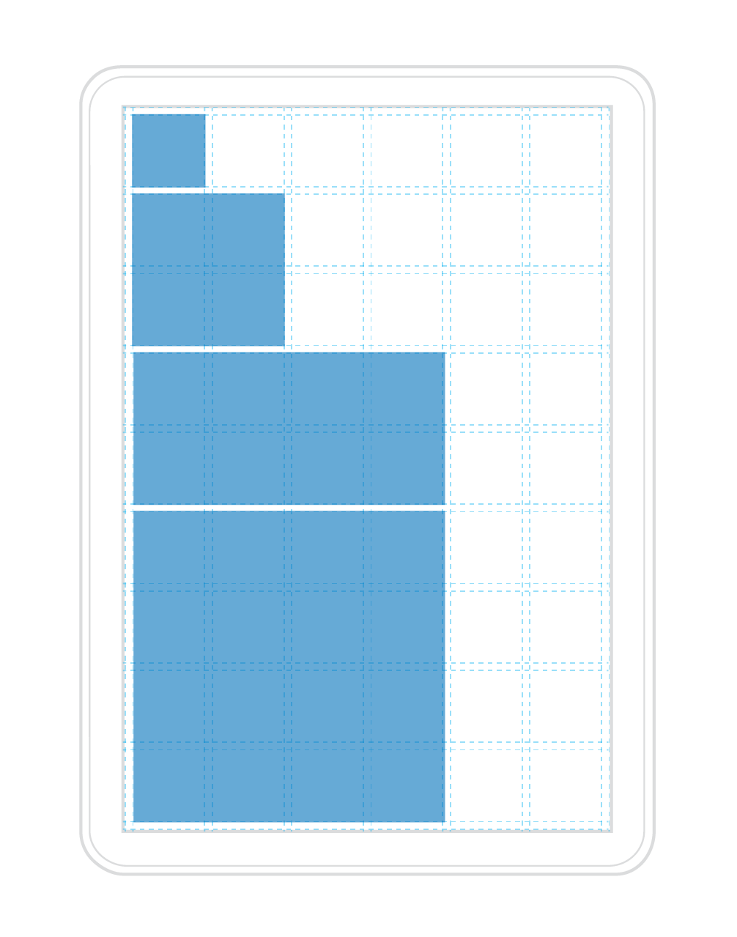
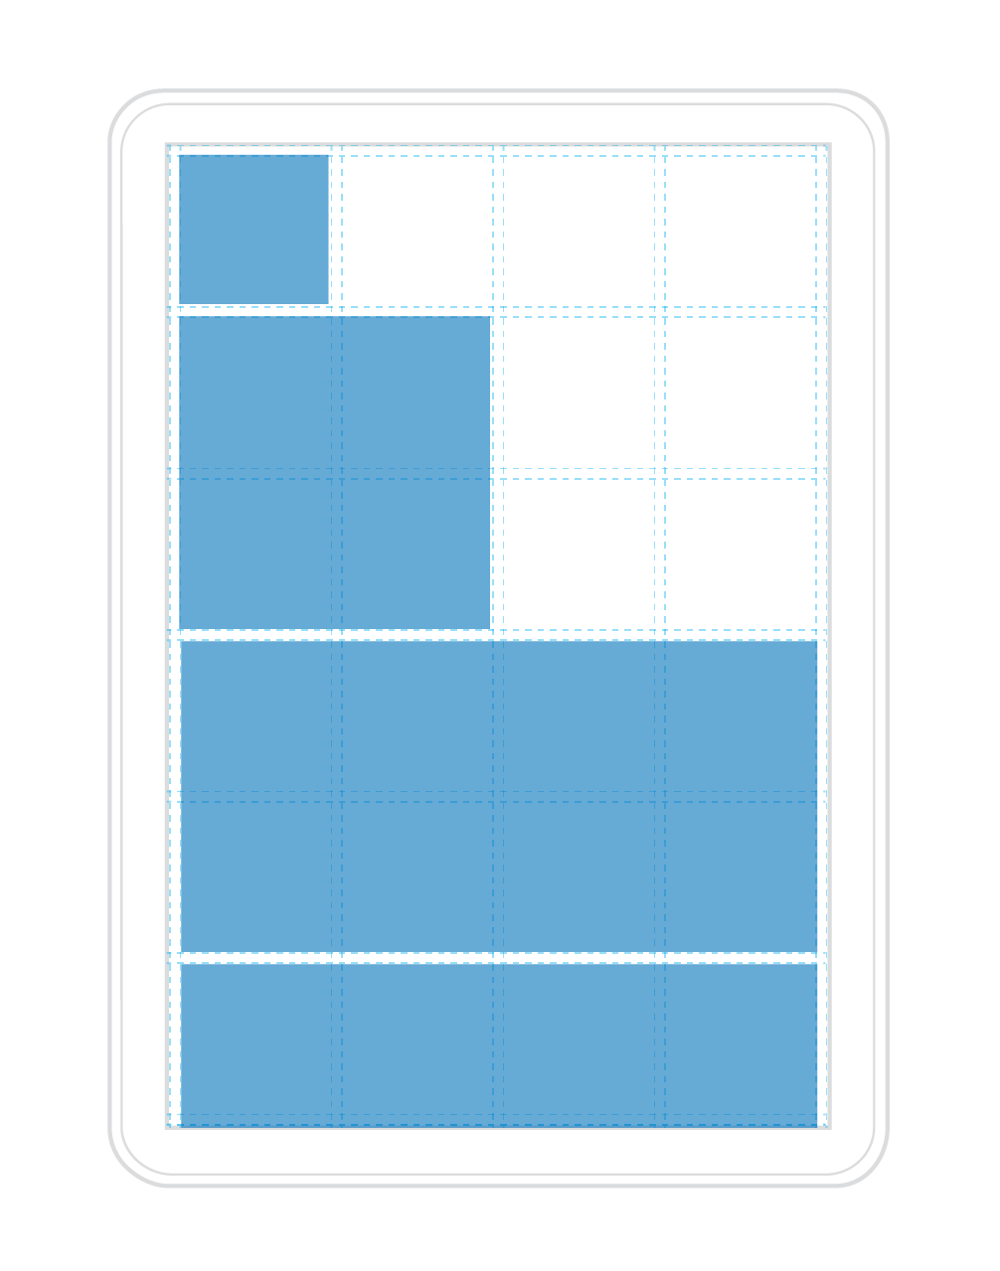
Responsive Tile Sizes
High density example
Low density example
Tiles are not always the same size…
…they adapt to the screen they’re on Since the Start grid has different densities and adapts to the screen size of your device, so do our tiles and the content within them.
Note: This use to be exclusive to mobile, but now includes desktop as well.

Slide 21
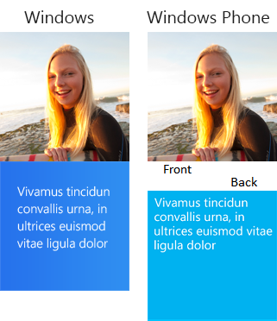
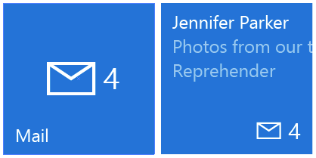
Tile Templates
Legacy Templates If there is a template that already meets your needs perfectly, feel free to use the legacy template catalog. There are over 80 different templates available for use.
Adaptive Tile Templates (Windows App) The adaptive tile template is our most flexible tile we’ve ever had. This template allows you to put the content you want on the tiles, how you want it, and have it work across all of Windows phone, tablet, and PC devices.

Slide 22
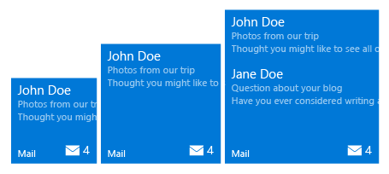
Adaptive Tile Template
Content adapts with the tile The new adaptive tile template works similarly to universal app patterns by allowing your content to adapt depending on the devices screen density. As you design your tiles it is important to keep in mind how you want your content to adapt to the tiles size on screens of different densities.
XML SAMPLE 1
<tile>
<visual>
<binding template="TileMedium">
<group>
<subgroup>
<text hint-style="subtitle">John Doe</text>
<text hint-style="subtle">Photos from our trip</text>
<text hint-style="subtle">Thought you might like to see all of</text>
</subgroup>
</group>
<group>
<subgroup>
<text hint-style="subtitle">Jane Doe</text>
<text hint-style="subtle">Questions about your blog</text>
<text hint-style="subtle">Have you ever considered writing a</text>
</subgroup>
</group>
</binding>
</visual>
</tile>
Content adjusts to screen density?
Min. Med Size
Max Med. Size

Slide 23
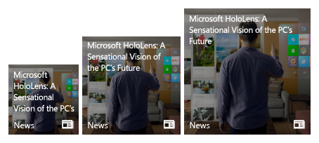
Adaptive Tile Template
Content adapts with the tile The new adaptive tile template works similarly to universal app patterns by allowing your content to adapt depending on the devices screen density. As you design your tiles it is important to keep in mind how you want your content to adapt to the tiles size on screens of different densities.
Wrap/reflow text?
XML SAMPLE 2
<tile>
<visual>
<binding template="TileMedium">
<text hint-wrap=“true">Microsoft HoloLens: A Sensational Vision of the PC’s Future
</text>
</binding>
</visual>
</tile>
Min. Med Size
Max Med. Size

Slide 24
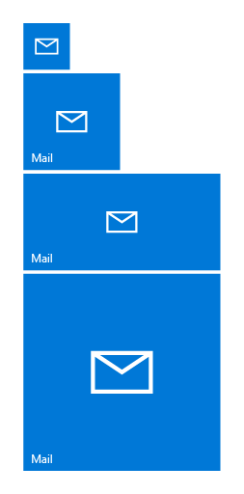

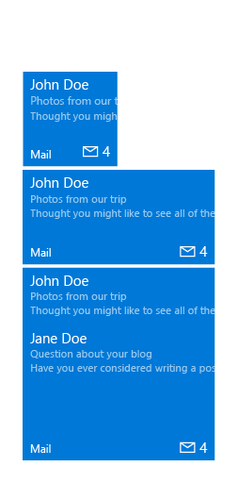
Adaptive Tile States
TileSmall
TileMedium
TileWide
TileLarge
Basic State The default, simplest state of your tile. This state highlights the app’s branding elements to make it clear what the app is.
Semi-Live State This state allows you to display a badge notification on your tile to indicate a change in your app (e.g. new, status, etc.).
Live State This state allows you to provide timely, relevant content through a notification so the user can make a more informed decision about launching your app.

Slide 25

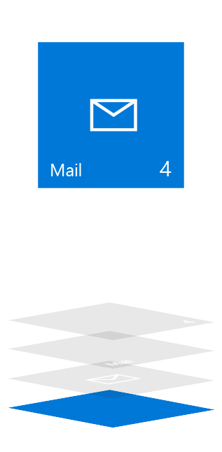
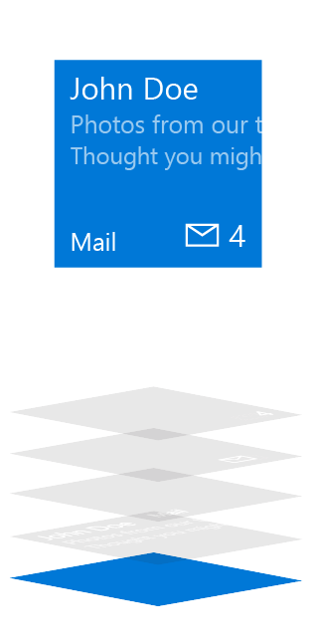
Adaptive Tile Elements and Composition
Basic State
Semi-Live State
Live State
Plate
Plate
Plate
Content
App Logo (Square150x150Logo)
App Logo (Square150x150Logo)
App Icon (Square44x44Logo)
Badge
Badge
Short Name
Short Name
Short Name
Badge
Badge
App Icon (Square44x44Logo)
Short Name
Short Name
Short Name
App Logo (Square150x150Logo)
App Logo (Square150x150Logo)
Content
Plate
Plate
Plate

Slide 26
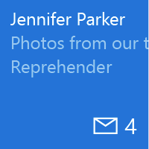
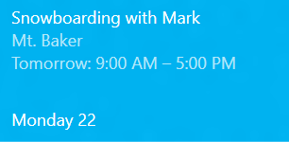
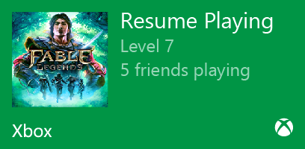
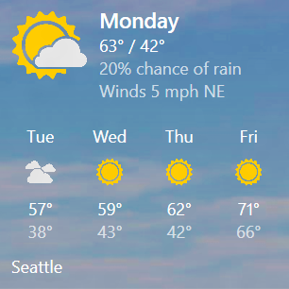
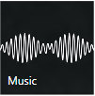
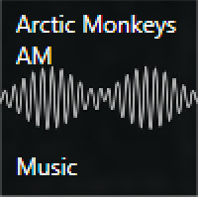
Adaptive Tile Elements: Content
Text
Text Columns
Content notifications can display image, text, or some combination of both. This is where you can customize your tile and get the most out of your live tile. Because these assets scale, baking text into the image asset isn’t ideal.
Inline Image and Text
Columns
Inline Image and Text Groups
Background Image
Background Image and Text

Slide 27
Toast and Action Center Principles

Slide 28
Action Center in Windows 10
The same look and feel for the Windows family
Behaviors inherited from Windows Phone Toast and Action Center… and more
Toasts automatically go into Action Center
Toasts can be expanded to view the full content
Chase individual notifications
Clear all
Remove per app group
Remove individual notifications
Alarms and reminders can now be viewed inside Action Center

Slide 29
Toast Basics

Slide 30

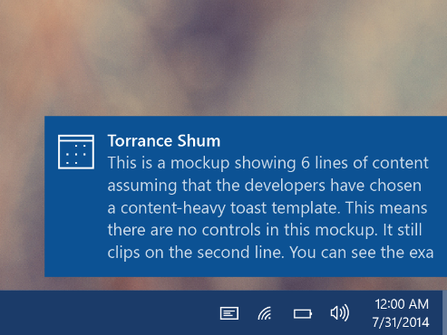
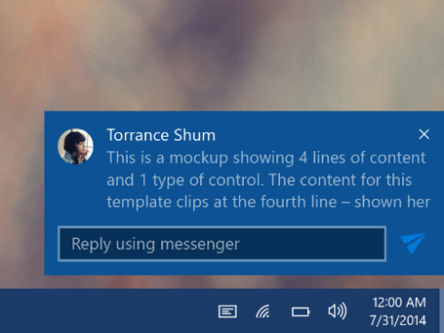
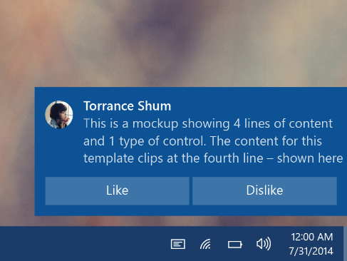
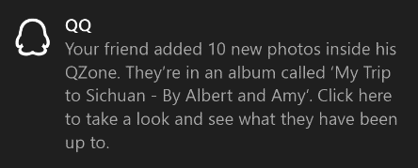
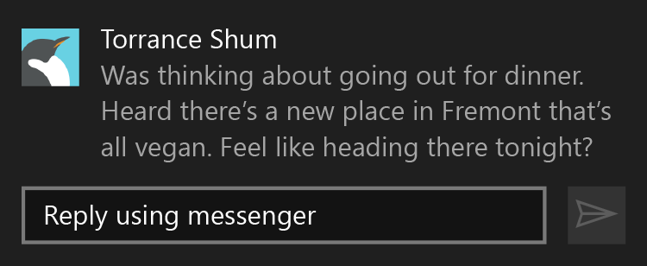
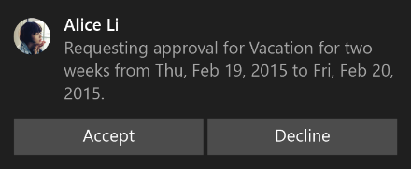
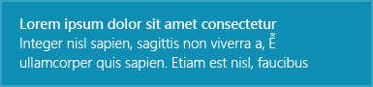
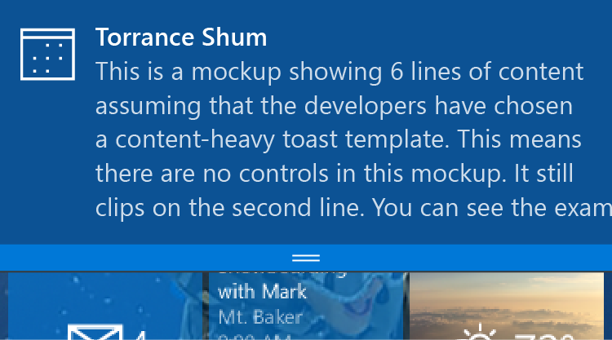
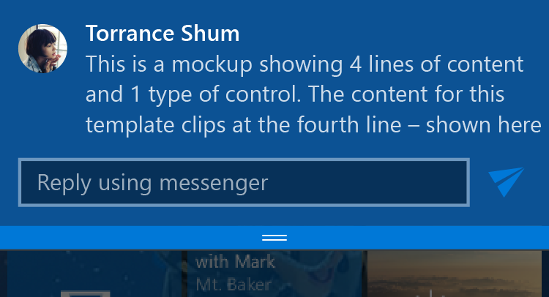
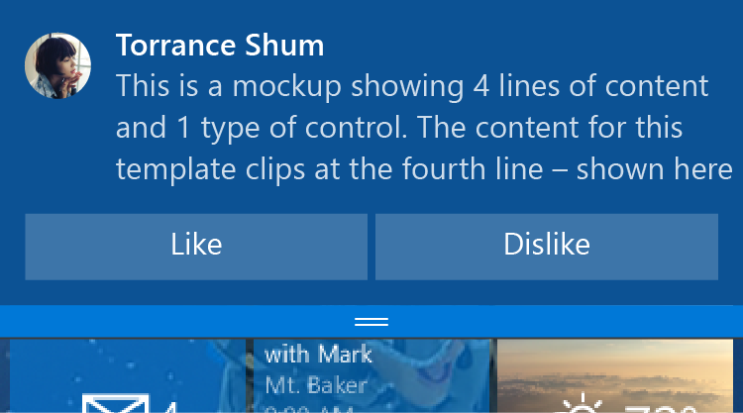
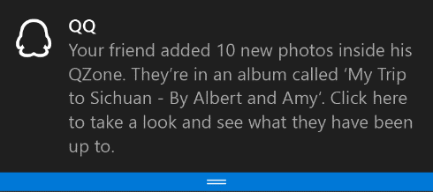
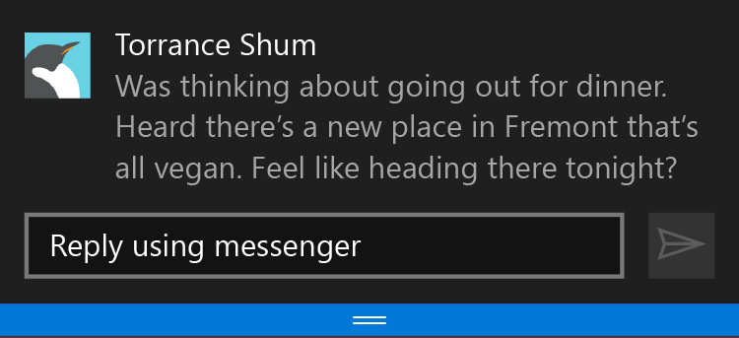
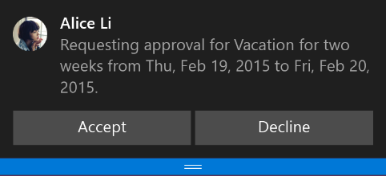
Toast Templates
Legacy Templates If there is a template that already meets your needs perfectly, feel free to use the legacy template catalog. There are 8 different templates available for use and previously Windows only template features, like inline images, are now fully working on Windows Phone.
Adaptive and Interactive Toast Template (Windows App) The adaptive toast template is our most flexible toast we’ve ever had. This template allows you to put the content you want on the toast, how you want it, and have it work across all of Windows phone, tablet, and PC devices. It allows you to add interactivity to quickly reply to a message, accept an invite, like something on a social network, or snooze an alarm.
Desktop
Mobile

Slide 31
Adaptive and Interactive Toast Templates

Slide 32
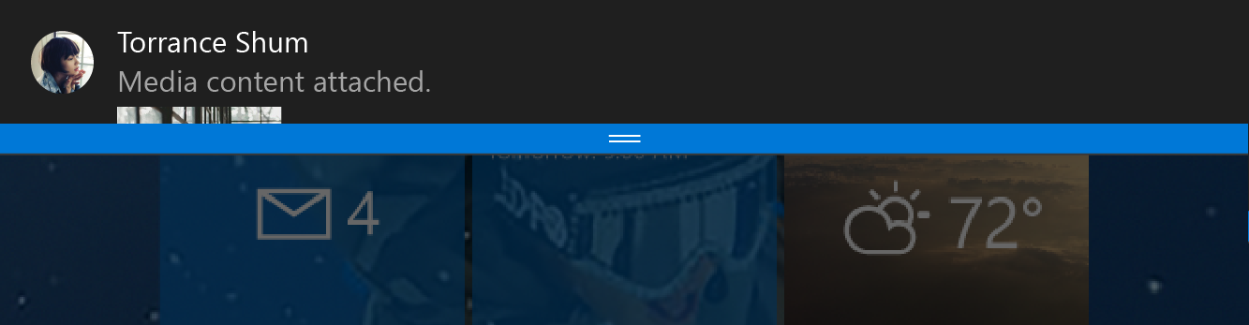
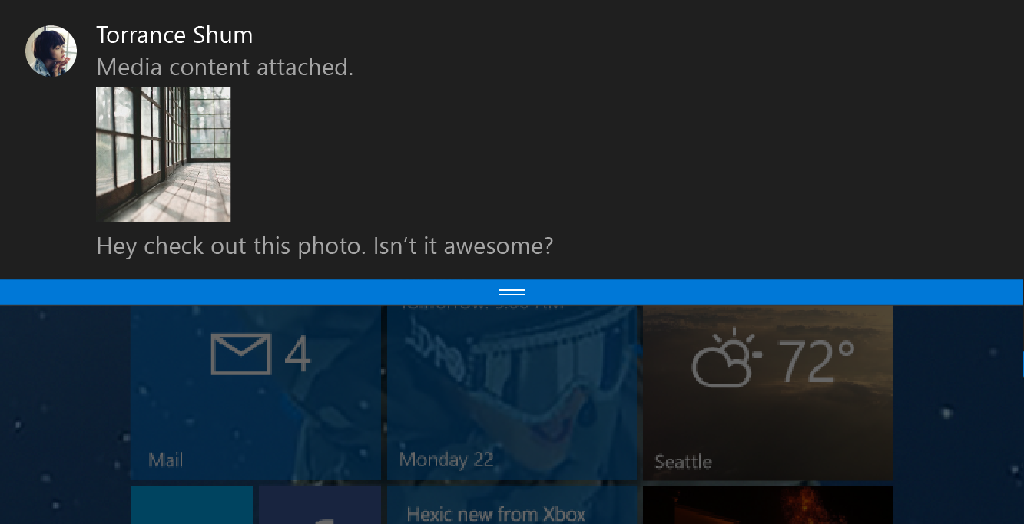
Adaptive Toast Template
Content adapts with the toast The new adaptive toast template works similarly to universal app patterns by allowing your content to adapt depending on the toast’s size and state. As you design your toasts it is important to keep in mind how you want your content to adapt to the toasts size.
Show more content?
XML SAMPLE 1
<toast>
<visual>
<binding template=“ToastGeneric”>
<image placement=“appLogoOverride” src=“Torrance Shum.png” />
<text>Torrance Shum</text>
<text>Media content attached.</text>
<image placement=“inline” src=“attachment.png” />
<text>Hey check out this photo. Isn’t it awesome?</text>
</binding>
</visual>
</toast>

Slide 33
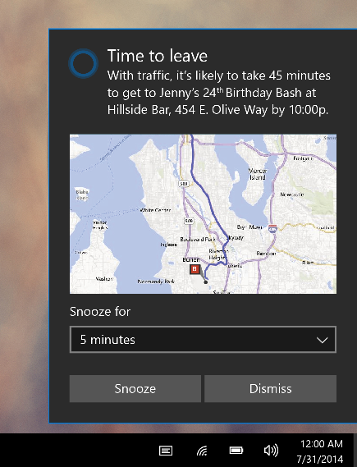
Adaptive Toast Template
Content adapts with the toast The new adaptive toast template works similarly to universal app patterns by allowing your content to adapt depending on the toast’s size and state. As you design your toasts it is important to keep in mind how you want your content to adapt to the toasts size.
Want actions?
XML SAMPLE 2
<toast>
<visual>
<binding template=“ToastGeneric”>
<text>Time to leave</text>
<text>With traffic…</text>
<image placement=“inline” src=“map.png” />
</binding>
</visual>
<actions>
<input title=“Snooze for” id="snoozeTime" type="selections" defaultSelection=“5">
<selection id="5" content="5 minutes" />
<selection id="10" content="10 minutes" />
<selection id="20" content="20 minutes" />
</input>
<action activationType="system" arguments="snooze" hint-inputId="snoozeTime" content=""/>
<action activationType="system" arguments="dismiss" content=""/>
</actions>
</toast>

Slide 34
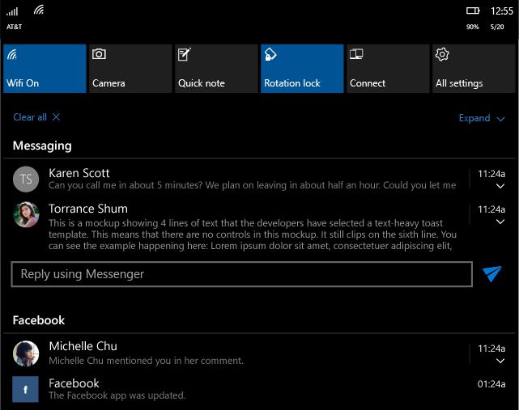
Adaptive Toast Template
Content adapts with the toast The new adaptive toast template works similarly to universal app patterns by allowing your content to adapt depending on the toast’s size and state. As you design your toasts it is important to keep in mind how you want your content to adapt to the toasts size.
More interactivity!
XML SAMPLE 3
<toast>
<visual>
<binding template=“ToastGeneric”>
<text>Torrance Shum</text>
<text>This is…</text>
<image placement=“appLogoOverride” src=“Torrance.png” />
</binding>
</visual>
<actions>
<input id=“1" type=“text“ />
<action activationType=“background" arguments=“quickReply" hint-inputId=“1" content="" imageUri=“send.png” />
</actions>
</toast>

Slide 35
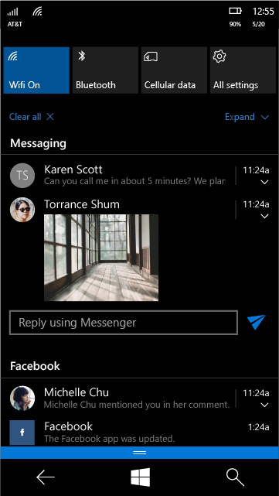
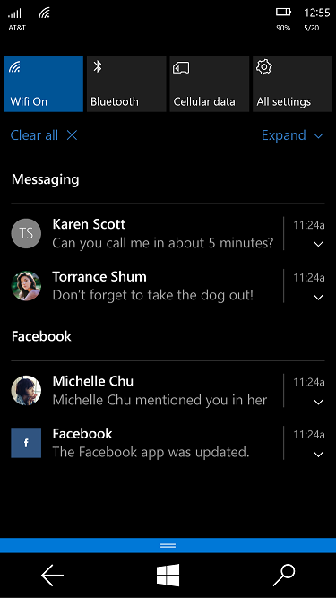
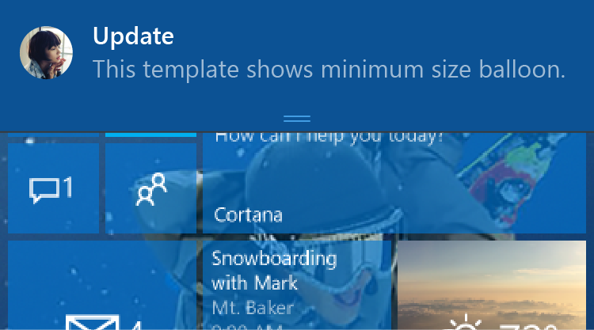
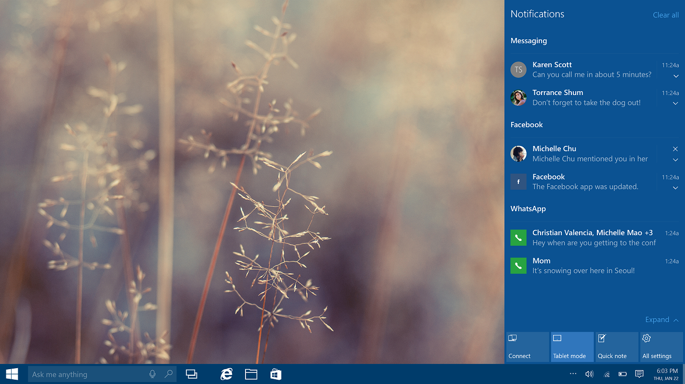
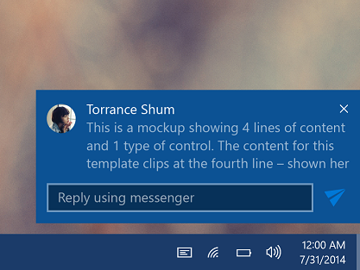
Adaptive Toast States
Collapsed State When the system has limited visual affordance to display the full notification, the notifications are displayed in “Collapsed State”
Notifications inside action centers on Mobile and Desktop are always in collapsed state by default for users to easily triage through them.
On Windows Mobile, a toast always shows up collapsed when it pops up, so it doesn’t affect user’s current task in an intrusive way. The exceptions are made for special scenarios like alarm, reminder, and incoming call.
Expanded State A collapsed notification can always be expanded by the user to unveil more contents and available actions and interactivities, no matter it is a toast notification banner, or an entry inside action center.
On Windows Desktop, a toast is always pre-expanded when it pops up, since there is enough screen real estate to show the full toast.

Slide 36
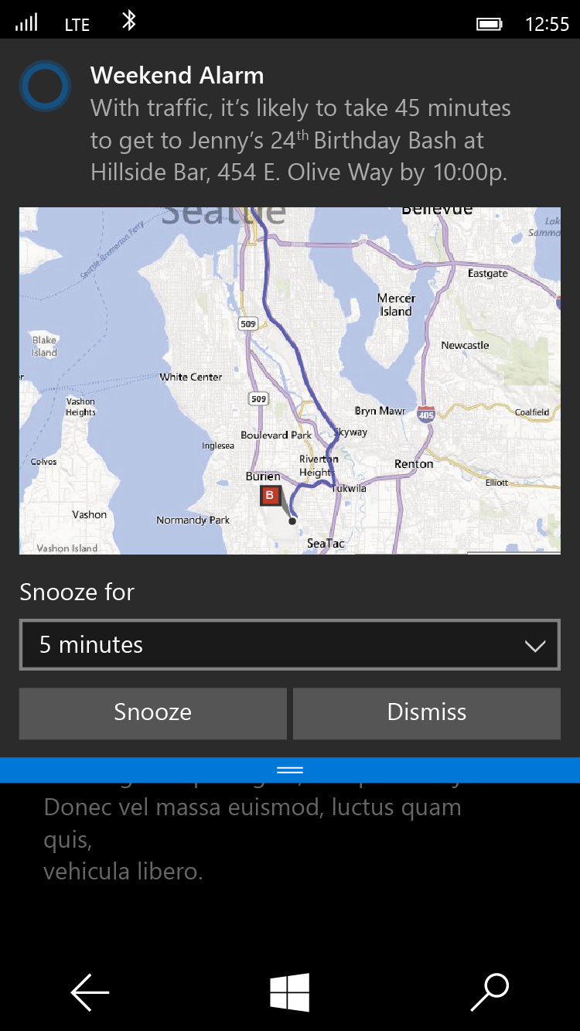
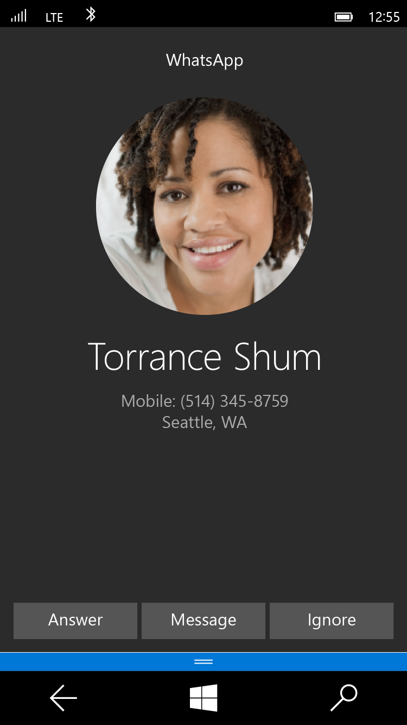
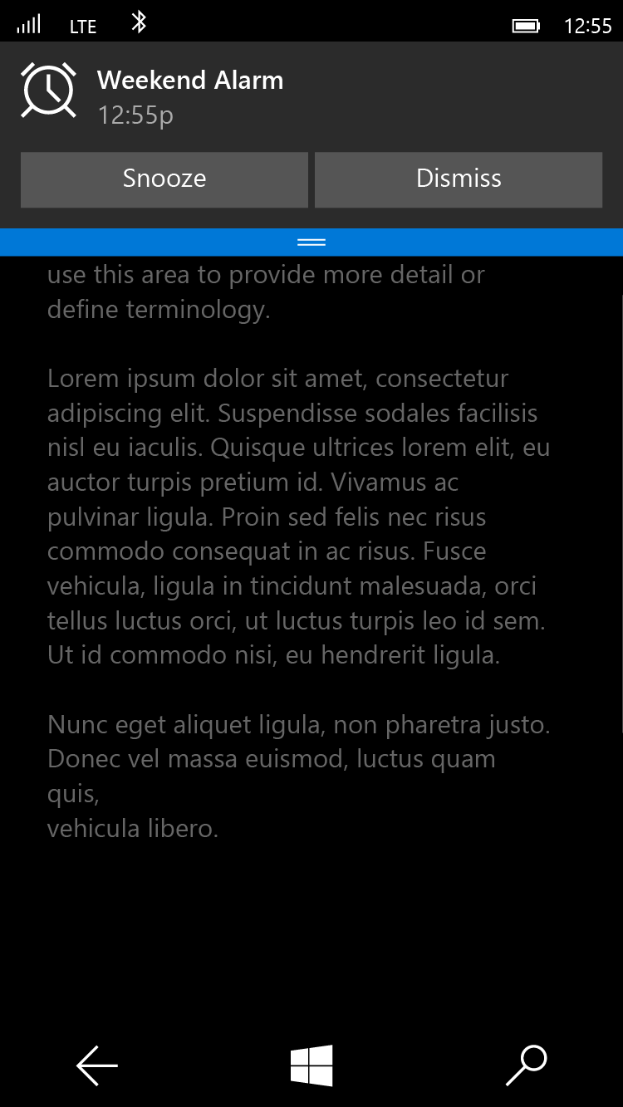
Adaptive Toast Scenarios
Alarm
<toast scenario=“alarm”...>
Reminder
<toast scenario=“reminder”...>
Incoming Call
<toast scenario=“incomingCall”...>

Slide 37
App to App Communication

Slide 38
App to App in Windows 8.1

Slide 39
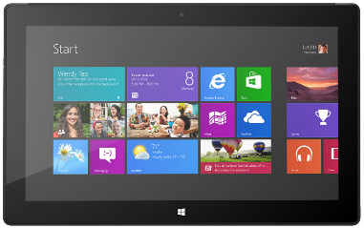
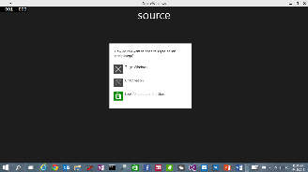
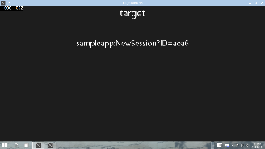
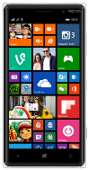
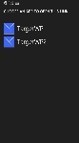
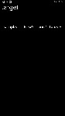
App to App in Windows 8.1
URI/Protocol Activation
Launcher.LaunchUriAsync(new Uri("sampleapp:?ID=aea6"));
Launcher.LaunchFileAsync(file);
Data in Uri/File
User/OS chooses target

Slide 40
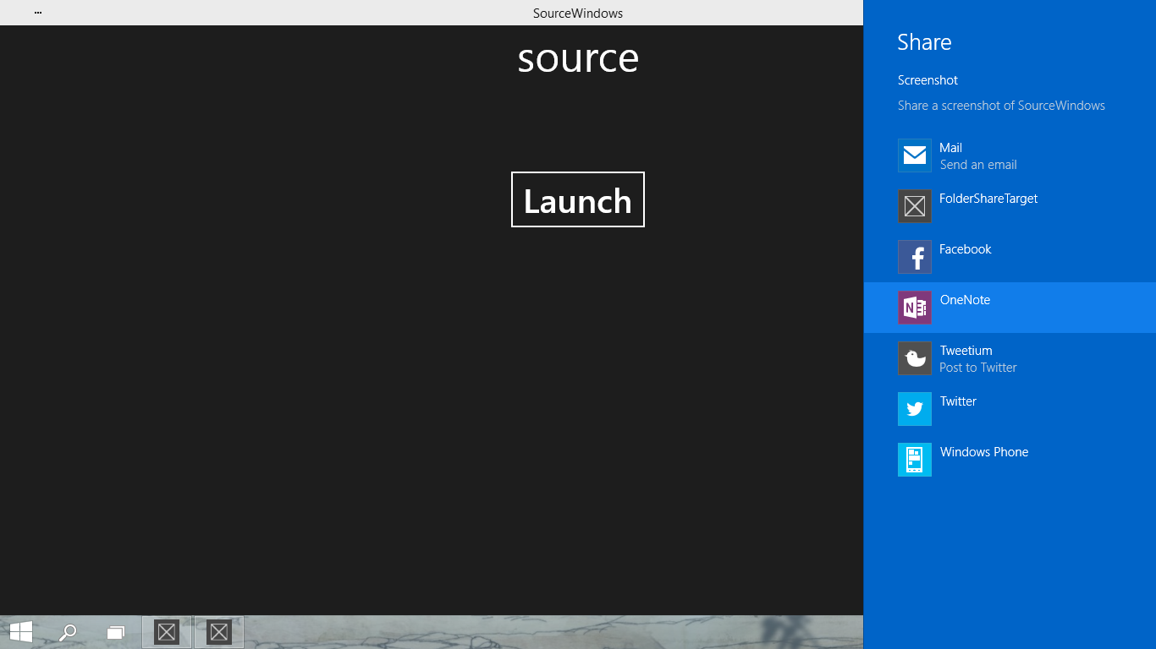

App to App in Windows 8.1
Share Contract
DataTransferManager.ShowShareUI();
Share DataPackage
User chooses target

Slide 41
App to App in Windows 10 UAP

Slide 42



Enhanced App to App in Windows 10
Launch a *specific* app
Send file token, send data
Launch for Results
App Services

Slide 43
URI Activation++
Invoke a specific app
var options = new LauncherOptions();
options.TargetApplicationPackageFamilyName = "24919.InstapaperIt";
var launchUri = new Uri("instapaper:?AddUrl=http%3A%2F%2Fbing.com");
await Launcher.LaunchUriAsync(launchUri, options);

Slide 44
URI Activation++
Send Files
var options = new LauncherOptions();
options.TargetApplicationPackageFamilyName = "24919.InstapaperIt";
var token = SharedStorageAccessManager.AddFile (gpxFile);
ValueSet inputData = new ValueSet();
inputData.Add("Token", token);
var launchUri = new Uri("instapaper:?AddUrl=http%3A%2F%2Fbing.com");
await Launcher.LaunchUriAsync(launchUri, options, inputData);

Slide 45
Query URI Support
Discover if app already installed to handle a Uri
var queryUri = new Uri("instapaper:");
await Launcher.QueryUriSupportAsync(queryUri, LaunchUriType.LaunchUri);
var queryUri = new Uri("instapaper:");
string packageFamilyName = "24919.InstapaperIt";
await Launcher.QueryUriSupportAsync(queryUri, LaunchUriType.LaunchUriForResults, packageFamilyName);
?

Slide 46


Launch for Results
Launching the app
var options = new LauncherOptions();
options.TargetApplicationPackageFamilyName = "24919.Instap";
var launchUri = new Uri("instapaper:?AddUrl=http%3A%2F%2Fbing.com");
await Launcher.LaunchUriForResultsAsync(launchUri, options, data);
var resultData = new ValueSet();
resultData.Add("Result", value);
operation.ProtocolForResultsOperation.ReportCompleted(resultData);A
App1
App2

Slide 47
App Services

Slide 48
What are App Services?
UAP offers many APIs that allow apps to interact with the platform
Windows.ApplicationModel.Contacts
Windows.ApplicationModel.Email
Windows.System.Launcher.LaunchUriAsync to launch settings, maps, store etc…
more…
UAP also allows apps to interact with each other
Uri Associations using LaunchUriAsync
File associations using LaunchFileAsync
Launch for results using LaunchUriForResultsAsync
App Services

Slide 49

Think ‘Web Services on device’
Client App A
App with App Service
Background Task
Client App B

Slide 50

Scenario: Bar Code Scanning
Bar Code decoding App Service
Image bytes in ValueSet or FileToken
Decoded data

Slide 51



Scenario: Enterprise suite of apps
Client App A
App Service
Maintains Inventory cache
Interact with cloud services
Client App B
App Service
Proximity Reading Services

Slide 52
App Services – Client
AppServiceConnection connection = new AppServiceConnection(); connection.AppServiceName = "microsoftDX-appservicesdemo"; connection.PackageFamilyName = "24919ArunjeetSingh.InstapaperIt"; AppServiceConnectionStatus connectionStatus = await connection.OpenAsync(); if (connectionStatus == AppServiceConnectionStatus.Success) { //Send data to the service var message = new ValueSet(); message.Add("Command", "CalcSum"); message.Add("Value1", Int32.Parse(Value1.Text)); message.Add("Value2", Int32.Parse(Value2.Text)); //Send message and wait for response AppServiceResponse response = await connection.SendMessageAsync(message); if (response.Status == AppServiceResponseStatus.Success) { int sum = (int)response.Message["Result"]; new MessageDialog("Result=" + sum).ShowAsync(); } } else { //Drive the user to store to install the app that provides the app service }

Slide 53
App Services – Service (1/2)
namespace AppServicesDemoTask { public sealed class AppServiceTask : IBackgroundTask { private static BackgroundTaskDeferral _serviceDeferral; public void Run(IBackgroundTaskInstance taskInstance) { // Associate a cancellation handler with the background task. taskInstance.Canceled += TaskInstance_Canceled; // Get the deferral object from the task instance _serviceDeferral = taskInstance.GetDeferral(); var appService = taskInstance.TriggerDetails as AppServiceTriggerDetails; if (appService.Name == "microsoftDX-appservicesdemo") { //Maybe ValidateCaller(appService.CallerPackageFamilyName) ?? appService.AppServiceConnection.RequestReceived += RequestReceived; } } ...

Slide 54
App Services – Service (2/2)
private async void RequestReceived(AppServiceConnection sender, AppServiceRequestReceivedEventArgs args) { var message = args.Request.Message; // This service uses a Command keyed entry for the client to invoke services from the App Service string command = message["Command"] as string; switch (command) { case "DoIt": { var messageDeferral = args.GetDeferral(); int value1 = (int)message["Value1"]; ... Do some processing //Set a result to return to the caller var returnMessage = new ValueSet(); returnMessage.Add("Result", result); var responseStatus = await args.Request.SendResponseAsync(returnMessage); messageDeferral.Complete(); break; } case "Quit": { //Service was asked to quit. Complete service deferral so platform can terminate _serviceDeferral.Complete(); break; } } }

Slide 55
Declaring App Service
<?xml version="1.0" encoding="utf-8"?> <Package xmlns="http://schemas.microsoft.com/appx/manifest/foundation/windows10" ... >
<Applications> <Application Id="App“ ... > <Extensions> <uap:Extension Category="windows.appService“ EntryPoint="AppServicesDemoTask.AppServiceTask"> <uap:AppService Name="microsoftDX-appservicesdemo" /> </uap:Extension> </Extensions> </Application> </Applications> <Capabilities> <Capability Name="internetClient" /> </Capabilities> </Package>

Slide 56
Two-way Communication
Client and server can keep a two-way chatty communication channel open
Client can attach a RequestReceived event handler to its own AppServiceConnection instance
Both client and server can send and receive messages
AppServiceConnectionStatus connectionStatus = await connection.OpenAsync(); if (connectionStatus == AppServiceConnectionStatus.Success) { connection.RequestReceived += OnRequestReceived; }

Slide 57
Apps from the same publisher share files and settings

Slide 58
Publisher’s shared storage folder
A subfolder is required. Edit app manifest to add. Folders are automatically provisioned.
<Package> <Extensions>
<Extension Category="windows.publisherCacheFolder"> <PublisherCacheFolder> <Folder Name="Folder1"> </PublisherCacheFolder> </Extension>
</Extensions> </Package>

Slide 59
Shared storage folder interaction
Access folder named “fonts”
Windows.Storage.ApplicationData.Current .GetPublisherCacheFolder("fonts");
Clear shared storage
Windows.Storage.ApplicationData.Current .ClearPublisherCacheFolderAsync();

